Slide 1
The Influence of Selection on Human cis-Regulatory Elements
Diego Rivera Gelsinger
Rotation #4
Dr. James Taylor’s Lab

Slide 2
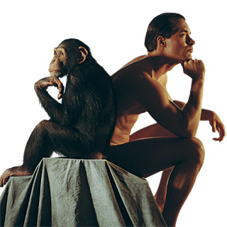
The 99.5%
Notes:
The chimpanzee has long presented a conundrum for human geneticists. The orthologous proteins of humans and chimpanzees are more than 99.5% identical [1], yet the two species differ profoundly across a broad spectrum of apparently unrelated phenotypes. This evident paradox led King and Wilson to speculate, famously, that differences in gene regulation, rather than protein-coding sequences, might primarily explain differences in physiology and behavior between humans and chimpanzees

Slide 3
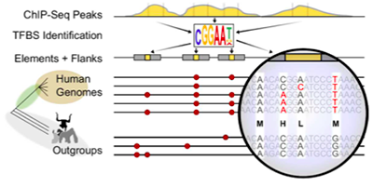
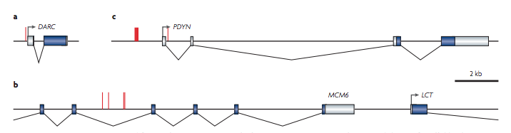
cis-Regulatory Elements
Duffy blood group
Cognitive Differences
Lactose tolerance
Notes:
It has long been argued that mutations affecting mechanisms of gene regulation must have had a prominent role in the evolution of humans and other mammals1, 2, 3. For several theoretical reasons, transcription factor binding sites and other cis-regulatory sequences may be particularly important in evolutionary adaptation4, 5, 6, 7. For example, mutations in such sequences might help to minimize the functional tradeoffs associated with evolutionary changes because these elements often primarily influence the expression of a single gene in a particular cell type or under a particular condition, whereas proteins tend to have broader effects. In addition, cis-regulatory mutations are often co-dominant (neither allele dominates), which may allow natural selection to act on them more efficiently than on protein-coding mutations.

Slide 4
Regulation of homologous genes drives divergence
Hypothesis: If regulatory machinery drives divergence between closely related species, we expect to find a high influence of natural selection in the sequence of non-coding regions of cis-regulatory elements.
Regions to study this can be transcription factor binding sites, histone methylation sites, and non-coding RNAs
Need interspecies variation and ancestral nucleotide state
Goal: Find differentially expressed homologous genes between Homo sapiens and non-human primates and infer the influence of selection on the regulatory regions of these genes

Slide 5
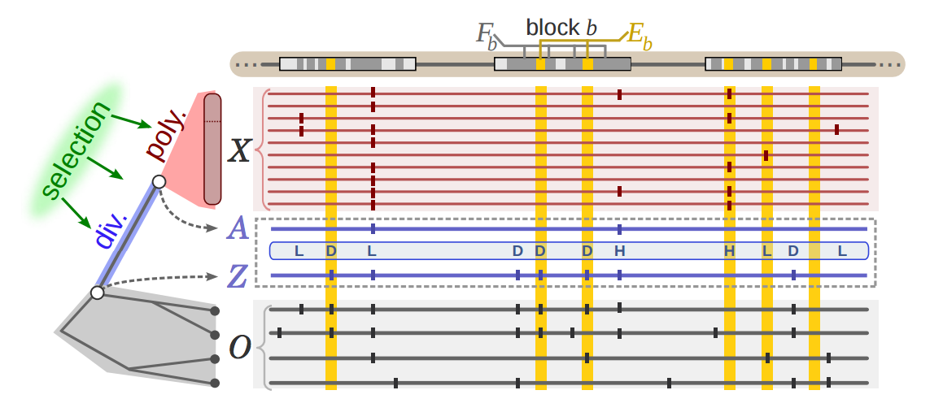
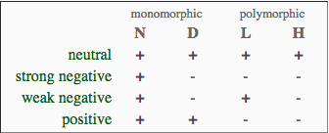
INSIGHT (Inference of Natural Selection from Interspersed Genomically coHerent elemenTs)
Notes:
The website also provides access to a server that can be used to run INSIGHT on any collection of human genomic elements, using our precomputed summaries of human polymorphism data

Slide 6
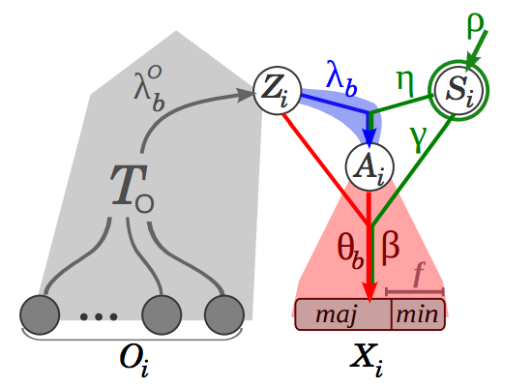
Probabilistic Method
Selection parameters
Divergence
Phylogenetic
Ancestry
Polymorphism
Notes:
INSIGHT infers signatures of recent natural selection from patterns of polymorphism and divergence across a collection of short dispersed genomic elements. The core of the method is a full probabilistic model that allows it to make use of sequence data across a dispersed set of elements to disentangle the effects of neutral genetic drift from positive, strong negative, and weak negative selection. INSIGHT provides estimates of three main measures: the fraction of nucleotides under selection (ρ), the number of divergences driven by positive selection (Dp), and the number of polymorphisms under weak negative selection (Pw).

Slide 7
Analysis Pipeline
RNA-seq
Differential Expressed Genes (Human genes relative to Chimp)
Statistically significant (False Discovery Rate < 5%)
Data
Filtering
Tissue-enriched genes (The Human Protein Atlas)
Down-regulated
Up-regulated
Data
Mining
cis-elements LINKED to a gene
DNaseI HSS specificity (ENCODE Project)
Natural
Selection
Analysis
INSIGHT
(precomputed summaries of human polymorphism on transcription
factor binding sites for 55 diverse human genomes)
ρ
Fraction of sites under
selection within
functional elements
E[A]
Sites under
positive selection
E[W]
Sites under
negative selection

Slide 8
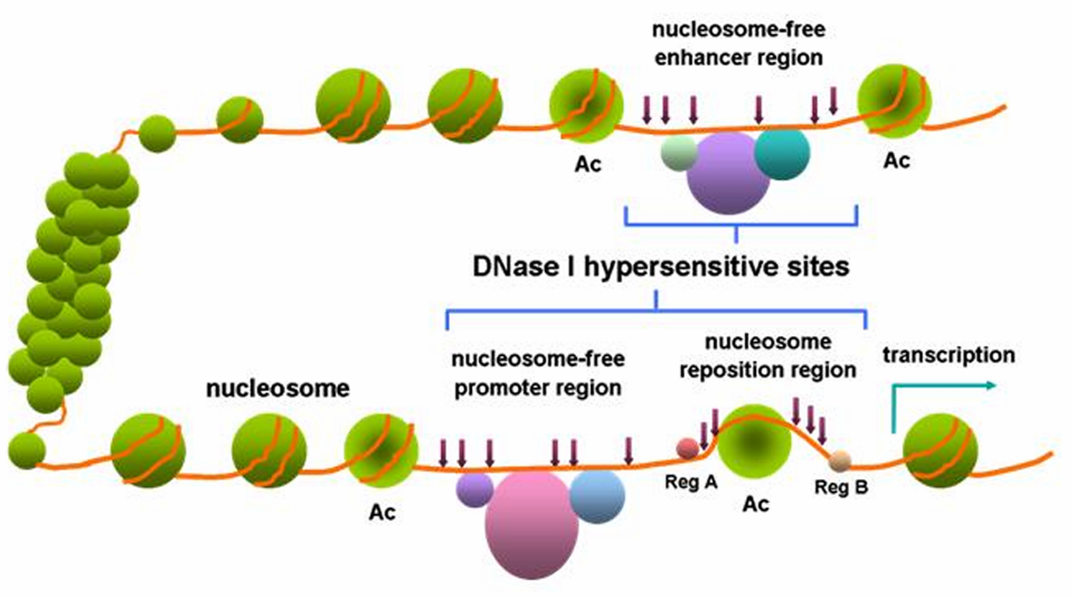
Dnase I hypersensitive sites are a sensitive measurement of promoter-enhancer sites
Distal
Proximal
Notes:
Find out how these sites were categorized as proximal vs distal
All DNase peaks from the above 14 cell lines were merged to form non­overlapping DNase­hypersensitive regions.
The merged DNase­hypersensitive regions were separated into TSS­proximal and TSS­distal groups based on whether or not they intersected a 2000­bp window centered on any GENCODE TSS (V19; gencode.v19.TSS.notlow.gff).
For each proximal and distal DNase­hypersensitive region, the DNase peak with the maximum score was labeled as a “master peak”
For each of the distal and proximal DNase master peaks, overlapping TF ChIP­seq peaks across all cell types (not restricted to above 14 cell lines) were identified. The TF peaks with maximum score in each master DNase peak

Slide 9
Differential Expression Analysis (Human relative to Chimpanzee)

Slide 10
Substantial Degree of Differential Expression in Muscle Tissue between Human and Chimp
Human changes relative to chimp

Slide 11
Larger Degree of Differentially Expressed Genes in the Prefrontal Cortex between Human and Chimpanzees
Human changes relative to chimp

Slide 12
Muscle Tissue Differential Expression Groups by Species
Chimp
Human

Slide 13
Prefrontal Cortex Tissue Differential Expression Groups by Species
Chimp
Human

Slide 14
Human Brain Tissue Exhibits More Up-regulation of Tissue-Specific Genes than Muscle Tissue
Up-regulated
Up-regulated
Down-
regulated
Down-
regulated

Slide 15
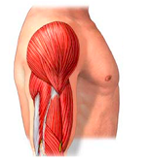
Influence of Selection on cis-Regulatory Elements of Muscle

Slide 16
Twice as Many Muscle-Enriched Genes are Up-regulated compared to Down-regulated

Slide 17
Larger proportion of Regulatory Elements of Up-regulated Brain Genes are Under Selection
Muscle Promoter
Brain Promoter
Muscle Enhancer
Brain Enhancer
Up-regulated Tissue-Specific Genes
Fraction of sites under selection within functional elements
Down-regulated Tissue-Specifc Genes

Slide 18
Proximal DNAseI HSS cis-Regulatory Elements (Promoters) of Down-Regulated Genes in the Human Muscle

Slide 19
Promoters of Down-regulated Muscle-specific Genes in Humans are Influenced by Negative Selection
ρ
E[A]
E[W]

Slide 20
Promoters of Down-regulated Genes in the Human Muscle are Under Selection

Slide 21
Adaptive Substitutions are Low in Promoters of Down-regulated Genes in the Human Muscle

Slide 22
Negative selection is more influential in down-regulated genes of the Human Muscle

Slide 23
Distal DNAseI HSS cis-Regulatory Elements (Enhancers) of Down-Regulated Genes in the Human Muscle

Slide 24
Enhancers of Down-regulated Muscle-specific Genes in Humans are Influenced by Negative Selection
ρ
E[A]
E[W]

Slide 25
Enhancers of Down-regulated Genes in the Human Muscle are Under Selection

Slide 26
More Adaptive substitutions in Enhancers of Down-regulated Genes in the Human Muscle

Slide 27
Wider Distribution of Negative Selection in Enhancers of Down-regulated Genes of the Human Brain

Slide 28
Proximal DNAseI HSS cis-Regulatory Elements (Promoters) of Up-Regulated Genes in the Human Muscle

Slide 29
Promoters of Down-regulated Muscle-specific Genes in Humans are Influenced by Negative Selection
ρ
E[A]
E[W]

Slide 30
Promoters of Up-regulated Genes in the Human Muscle are Under Selection

Slide 31
Adaptive substitutions are low in proximal DNAseI HS sites of down-regulated genes in the Human brain

Slide 32
Negative selection is more influential in Up-regulated genes of the Human Muscle

Slide 33
Distal DNAseI HSS cis-Regulatory Elements (Enhancers) of Up-Regulated Genes in the Human Muscle

Slide 34
Enhancers of Up-regulated Muscle-specific Genes in Humans are Influenced by Negative Selection
ρ
E[A]
E[W]

Slide 35
Enhancers of Up-regulated Genes in the Human Muscle are Under Selection

Slide 36
More Adaptive substitutions in Enhancers of Up-regulated Genes in the Human Muscle

Slide 37
Wider Distribution of Negative Selection in Enhancers of Up-regulated Genes of the Human Muscle

Slide 38
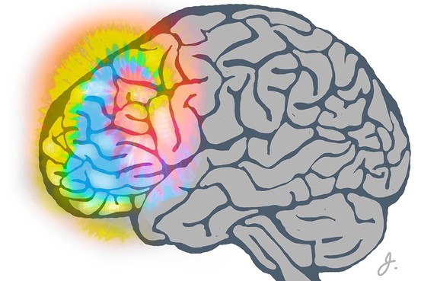
Influence of Selection on cis-Regulatory Elements of Prefrontal Cortex

Slide 39
Brain-Enriched Genes are Predominately Up-regulated in Humans compared to Chimpanzee

Slide 40
Proximal DNAseI HSS cis-Regulatory Elements (Promoters) of Down-Regulated Genes in the Human Prefrontal Cortex

Slide 41
Promoters of Down-regulated Brain-specific Genes in Humans are Influenced by Negative Selection
ρ
E[A]
E[W]

Slide 42
Promoters of down-regulated genes in the human brain are under selection

Slide 43
Adaptive substitutions are low in proximal DNAseI HS sites of down-regulated genes in the Human brain

Slide 44
Negative selection is more influential in down-regulated genes of the Human brain

Slide 45
Distal DNAseI HSS cis-Regulatory Elements (Enhancers) of Down-Regulated Genes in the Human Prefrontal Cortex

Slide 46
Enhancers of Down-regulated Brain-specific Genes in Humans are Influenced by Negative Selection
ρ
E[A]
E[W]

Slide 47
Enhancers of down-regulated genes in the human brain are under selection

Slide 48
More Adaptive substitutions in Enhancers of Down-regulated Genes in the Human Brain

Slide 49
Wider Distribution of Negative Selection in Enhancers of Down-regulated Genes of the Human Brain

Slide 50
Proximal DNAseI HSS cis-Regulatory Elements (Promoters) of Up-Regulated Genes in the Human Prefrontal Cortex

Slide 51
Promoters of Up-regulated Brain-specific Genes in Humans are Influenced by Positive Selection
ρ
E[A]
E[W]

Slide 52
Few Promoters of Up-regulated Genes in the Human Brain are Under Selection

Slide 53
Adaptive substitutions in Promoters of Up-regulated genes in the Human brain

Slide 54
Less Negative Selection in Promoters of Up-regulated Genes of the Human brain

Slide 55
Distal DNAseI HSS cis-Regulatory Elements (Enhancers) of Up-Regulated Genes in the Human Prefrontal Cortex

Slide 56
Enhancers of Up-regulated Brain-specific Genes in Humans are Influenced by Negative Selection
ρ
E[A]
E[W]

Slide 57
Enhancers of down-regulated genes in the human brain are under selection

Slide 58
More Adaptive substitutions in Enhancers of Up-regulated Genes in the Human Brain

Slide 59
Wider Distribution of Negative Selection in Enhancers of Up-regulated Genes of the Human Brain

Slide 60
Up-regulation Summary
Enhancers
Promoters
Muscle
Brain
Muscle
Brain
Muscle
Brain
Muscle
Brain
Notes:
More regulatory regions with positive selection in brain compared to muscle (both promoters and enhancers.

Slide 61
Down-regulation Summary
Enhancers
Promoters
Muscle
Brain
Muscle
Brain
Muscle
Brain
Muscle
Brain

Slide 62
Acknowledgements
Taylor Lab
Mike Sauria
Nitesh
Enis
Dr. James Taylor
YUE Lab
ENCODE Project
INSIGHT-EM Team

Slide 63
Questions?

